Slide 1

GEORGIA BREWERIES
Team Megadatatron
Eduardo Alfaro, Maria Dong, Shahil Jani,
Audrey Lawrence, Jimmy Lee
https://cdnph.upi.com/svc/sv/upi/8241514915482/2018/1/e29c09a8a452d1345a0946836117b6e9/Calvin-Johnson-isnt-coming-back-to-the-NFL-and-doesnt-miss-football.jpg
Notes:
jimmy: intro

Slide 2

MOTIVATIONS & SUMMARY
Background:
An ice cold beer is a majestic and wonderful thing. There’s only 4 ingredients. Can you name them?
Core Hypothesis:
We believe that small production breweries in Georgia tend to be located near areas with more young adults (ages 18 - 30), a key target demographic for this type of business
Questions:
Which type of brewery is the most popular?
How are breweries dispersed in Georgia?
Is there a relationship between brewery location and college campuses?
What’s the relationship between brewery location and population demographics?
Notes:
Summary:
discuss types of brewery
Microbreweries & brewpubs = majority (good place to define them too)
Average 3mi from nearest college
*some population conclusion here, probably in areas w/ younger adults (18-30)

Slide 3



DATA CLEANUP & EXPLORATION
OpenBreweryDB
Missing information
Breweries “in planning”
Places API
Definition of “university” type
Census.gov API
https://github.com/openbrewerydb/openbrewerydb/blob/master/OpenBreweryDBLogo.png
https://developers.google.com/maps/documentation/javascript/places
https://miro.medium.com/max/1200/1*zT_8ermTc8YwTFnEWLiyIA.jpeg
Notes:
jimmy
openbreweryDB
some brewery lats/lngs missing
included breweries “in planning”
places API
does not exclusively return universities; returned a preschool, photography studio, residence, dance studio, etc.
did not know how many technical colleges are in georgia (88 campuses)
DESCRIBE THE EXPLORATION AND CLEANUP PROCESS DISCUSS INSIGHTS YOU HAD WHILE EXPLORING THE DATA THAT YOU DIDN'T ANTICIPATE
DISCUSS ANY PROBLEMS THAT AROSE AFTER EXPLORING THE DATA, AND HOW YOU RESOLVED THEM PRESENT AND DISCUSS INTERESTING FIGURES DEVELOPED DURING EXPLORATION, IDEALLY WITH THE HELP OF JUPYTER NOTEBOOK

Slide 4
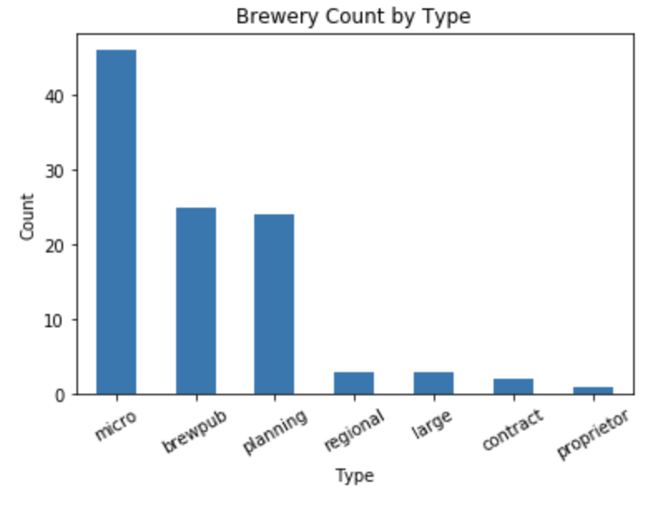
Analysis 1: Types of Breweries
Governing Questions
What are the different types of breweries?
Which ones are available in Georgia?
How many of each type are available per city?
API
Open Brewery DB
Filer data to show Georgia
Notes:
eduardo
Read questions
Open Brewery DB is a free API for public information on breweries, cideries, brewpubs, and bottleshops in the US
Microbrewery: independently owned, produces small amounts of beer. Often selling products locally.
Brewpub: establishment selling beer brewed on the premises and often included a restaurant
Planning: It has not yet open. In the planning stages.
Regional, Large: 15k-6M, 6M+ barrels
Contract: Third party brewery produces recipe.

Slide 5
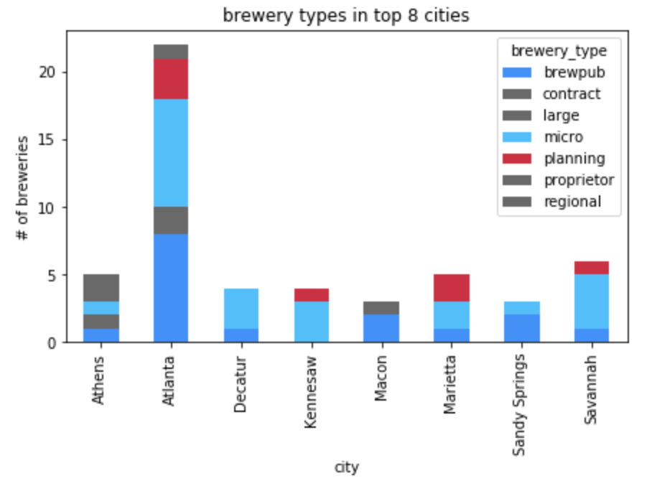
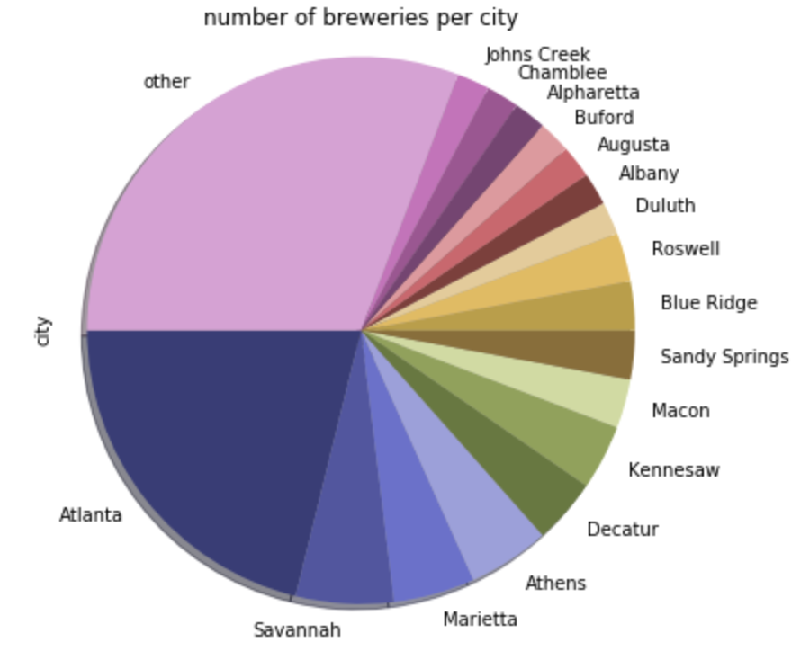
Analysis 1: Types of Breweries
Notes:
eduardo
Read questions
Open Brewery DB is a free API for public information on breweries, cideries, brewpubs, and bottleshops in the US

Slide 6
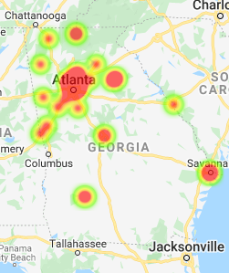
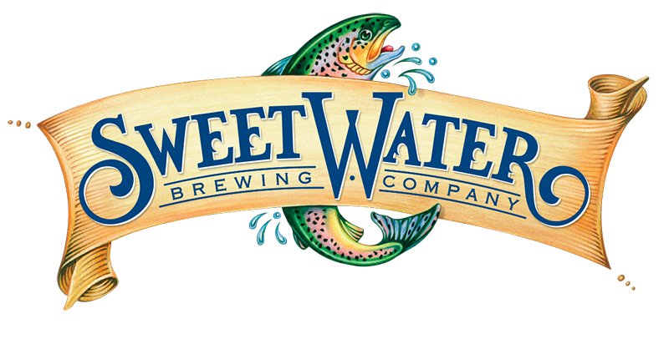

Analysis #2: Density of Microbreweries/Brewpubs in Georgia
Preliminary analysis
Google Places + BreweryDB
Microbreweries/brewpubs around large cities
Centered mostly around Atlanta metro area and surrounding suburbs
Notes:
shahil: analysis 2

Slide 7
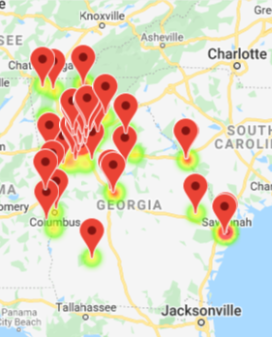
Analysis #3: Breweries & College Campuses
Are craft breweries likely to be within 5 miles of a college campus?
Google Maps: Places API
“type” = “university”
“keyword” = “college”
“radius” vs. “rankby”
Qualitative view with jupyter gmaps
Notes:
maria: analysis 3
further questions: where is the nearest college to each brewery? & most relevant? (selecting a larger facility like GT instead of something smaller like a technical college)
openbreweryDB gave us lats/lngs of most breweries, we used places API to populate remaining lats/lngs if missing
used those coordinates in places API, nearby search
used “radius” instead of “rankby” d/t relevancy of some results. “type” = “university” does NOT yield only university results; big shortcoming
created marker layer w/ college coordinates & info boxes in jupyter gmaps to display colleges in relation w/ breweries

Slide 8
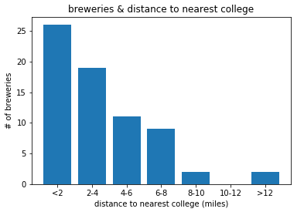
Analysis #3: Breweries & College Campuses
Are craft breweries likely to be within 5 miles of a college campus?
geopy module
Calculate distance between two sets of coordinates
*Live coding
Quantitative view with a binned bar chart
mean: 3.56 min: 0.2
median: 2.95 max: 20.16
Notes:
maria: analysis 3
using the brewery coords & college coords, we used the geopy module to calculate distance in miles b/w each set of coordinates
binned the results & put into a bar graph; the 0-2mile category had the most breweries; the average distance was 3.66miles; shows a right skew

Slide 9
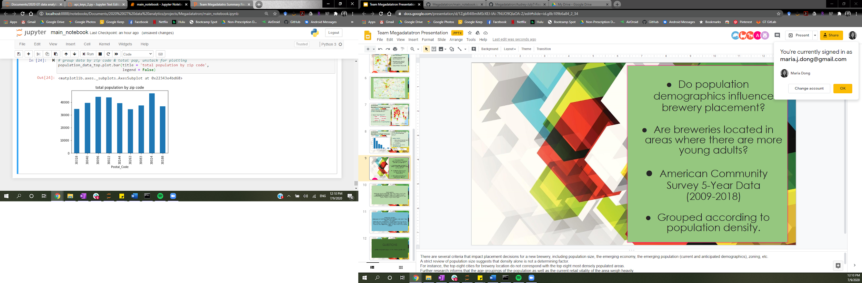
Analysis #4: Breweries & Population Density
Does population density influence brewery placement?
Are breweries located in areas where there are more young adults?
American Community Survey 5-Year Data (2009-2018)
Grouped according to population density.
Notes:
There are several criteria that impact placement decisions for a new brewery, including population size, the emerging economy, the emerging population (current and anticipated demographics), zoning, the retail environment, etc.
A strict review of population size suggests that density alone is not a determining factor.
For instance, the top eight cities for brewery location do not correspond with the top eight most densely populated areas.
Further research informs that the age groupings of the population as well as the current retail vitality of the area weigh heavily.
Especially for microbreweries which have a retail goal.
Unlike larger, production breweries which favor economy of real estate, necessary land mass and interstate access.

Slide 10
General Conclusions
popularity of microbreweries/brewpubs
density of microbreweries/brewpubs
relationship between college location and brewery location
relationship between population size and brewery location
Notes:
shahil
DISCUSSION DISCUSS YOUR FINDINGS. DID YOU FIND WHAT YOU EXPECTED TO FIND? IF NOT, WHY NOT? WHAT INFERENCES OR GENERAL CONCLUSIONS CAN YOU DRAW FROM YOUR ANALYSIS?
There are several criteria that impact placement decisions for a new brewery, including population size, the emerging economy, the emerging population (current and anticipated demographics), zoning, the retail environment, etc.
A strict review of population size suggests that density alone is not a determining factor.
we found that there is most likely to be a brewery 5 miles with a mean of around 3 miles from a college campus correlation vs causation there tends to be more college campuses in booming areas

Slide 11
Socio-economic influencers
Impact of retail environment
Trend of craft brewery emergence
Accuracy of Google places API
Malleability of Census Data
Size of Data Set
Additional Questions
Difficulties Faced
Notes:
shahil & audrey
CONCLUSION DISCUSS ANY DIFFICULTIES THAT AROSE, AND HOW YOU DEALT WITH THEM DISCUSS ANY ADDITIONAL QUESTIONS THAT CAME UP, BUT WHICH YOU DIDN'T HAVE TIME TO ANSWER: WHAT WOULD YOU RESEARCH NEXT, IF YOU HAD TWO MORE WEEKS?
Additional Questions:
What is the trend of craft brewery emergence in the last decade?
What influence does the presence of other restaurants have on brewery placement? (Would research next)
What is the median age of the population near breweries?
Does income level of the surrounding population impact placement of brewery placement? (Would research next)
what is the distribution of gender and ethnicity of people that go to breweries? (Would research next)
difficulties
google places not returning universities

Slide 12
QUESTIONS OPEN-FLOOR Q&A WITH THE AUDIENCE
Notes:
shahil or audrey, whoever’s still talking can ask for questions
whoever wants to answer can answer

